Slide 1


Student Mental Health Survey

Slide 2
Team members
01
02
03
04
Lorna Magdy
Ramzy
Marina Maged
Mofied
Youssef Kamel
Kamel
Ibrahiem Saeid
Ibrahiem
Under the supervision of DR/Sarah Beshir

Slide 3

Introduction

Slide 4
Key aspects covered in the dataset include:
Demographics: Gender, age, university, and residential status.
Academic Factors: Degree level, major, academic year, CGPA, academic pressure, and satisfaction with studies.
Mental Health and Well-being:
Depression, anxiety, isolation, and future insecurity.
Discrimination and bullying on campus.
Social Relationships: Impact on mental health, particularly the effects of poor social relationships.
Lifestyle Factors: Sleep, physical activity, and stress-relief activities (notably, religious activities being most effective).

Slide 5
Objective:
The project aims to explore the relationships between student demographics, academic performance, and mental health. The goal is to identify key factors that influence student well-being, stress levels, and their coping mechanisms.

Slide 6
Data collection Method

Slide 7
This data is available on Kaggle via:
Student mental health survey

Slide 8
Data preparation

Slide 9
We have explored data using python and checked for:
-Duplicates: No duplicates were found.
-Null values: No nulls were replaced or deleted.
-Metadata: All columns were named by data provider.

Slide 10
Objectives and insights

Slide 11
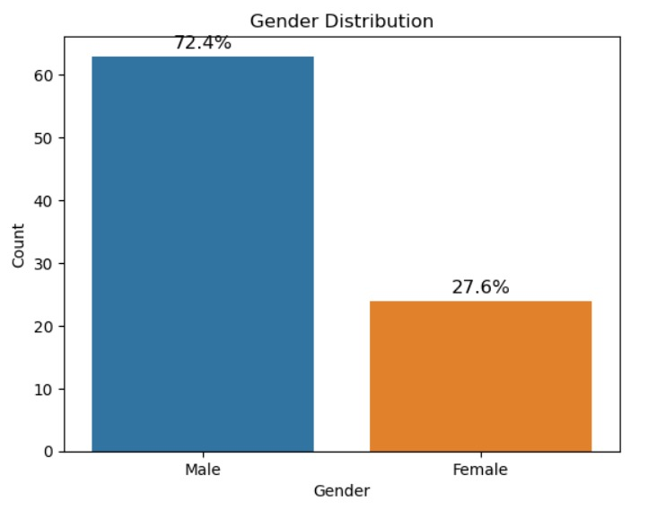
1. Are males more than females in IT?
We have noticed that males are more than females contributing more than 60%.

Slide 12
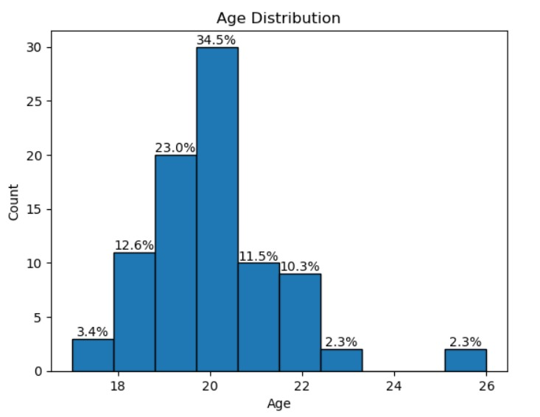
2. What is the age distribution in this field?
Age distribution: younger students represent great population, as there are more undergraduate students.

Slide 13
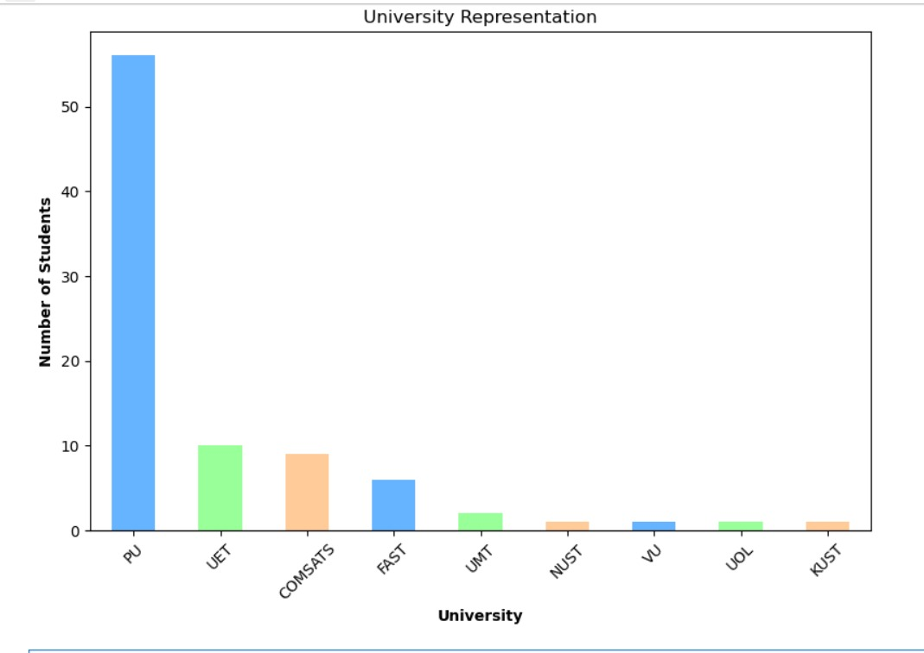
3. Which university has more students?
University with most students is PU.

Slide 14
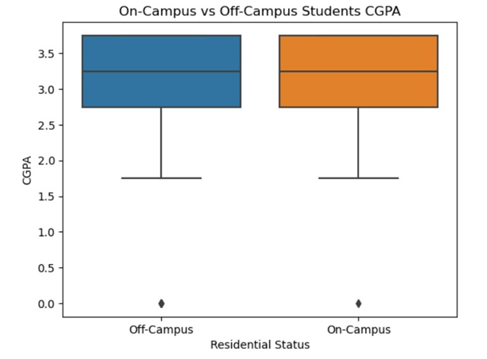
4. Are on-campus students getting more grades?
There is no significant difference between on-campus and off-campus students.

Slide 15
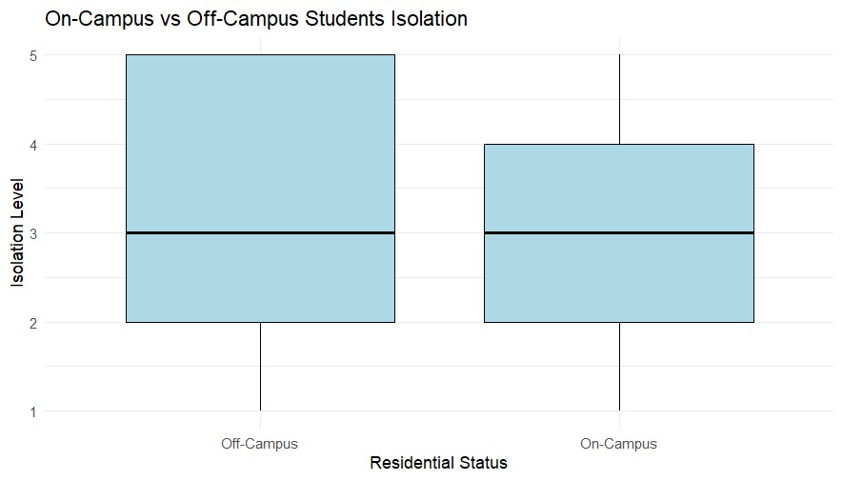
5. Are on-campus students feeling more isolation?
More Off-campus students are feeling isolation.

Slide 16
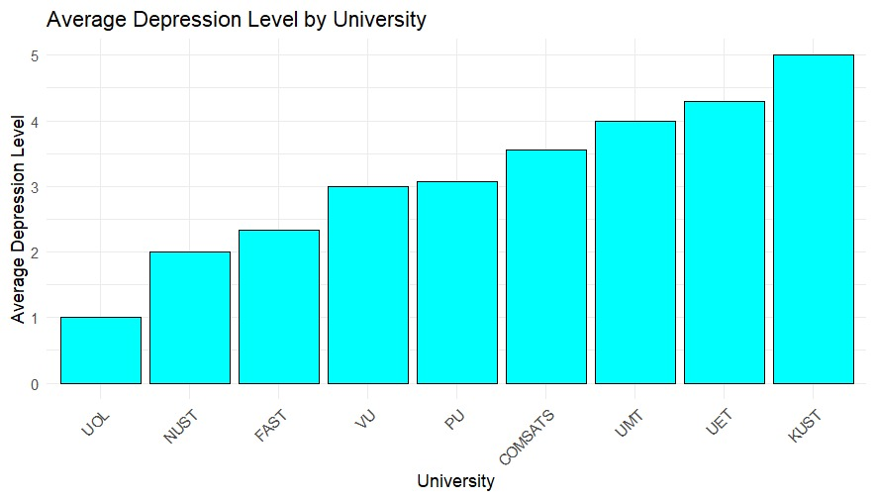
6. Is there specific university with most depressed students?
KUST has the most percentage
of depressed student.

Slide 17
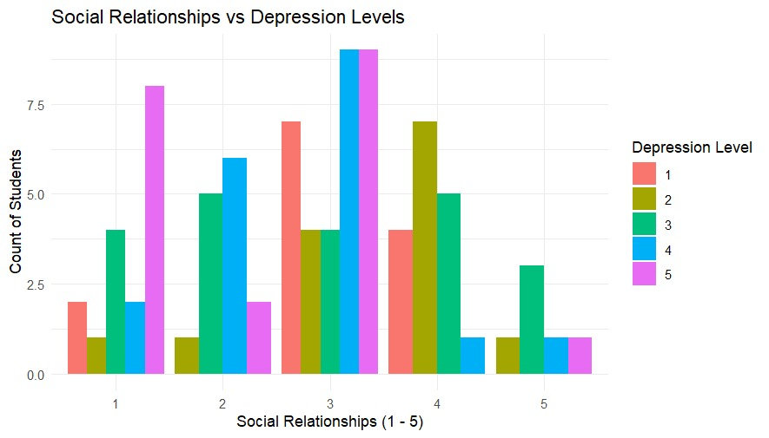
7. Is there a social relationships /mental health relation?
Very bad social relation is strongly correlated with High Anxiety level. However, it seems to be a co-factor, not a key factor by itself.

Slide 18
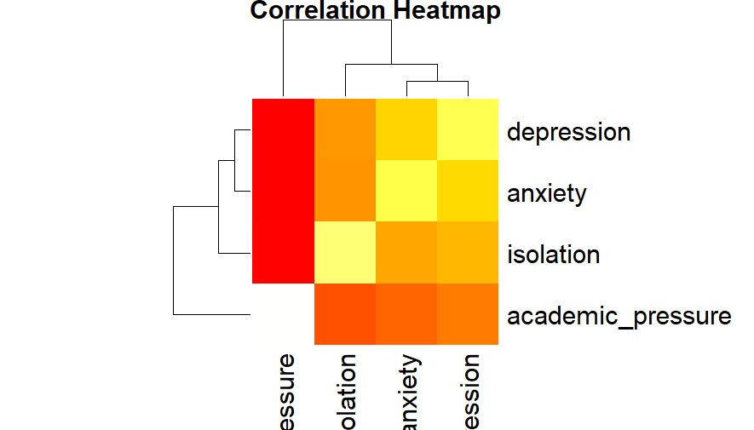
8. Is there a Correlation between academic pressure and levels of depression, anxiety, and isolation?
students with higher CGPA experienced more stress, and there is a correlation between academic pressure and mental health outcomes.

Slide 19
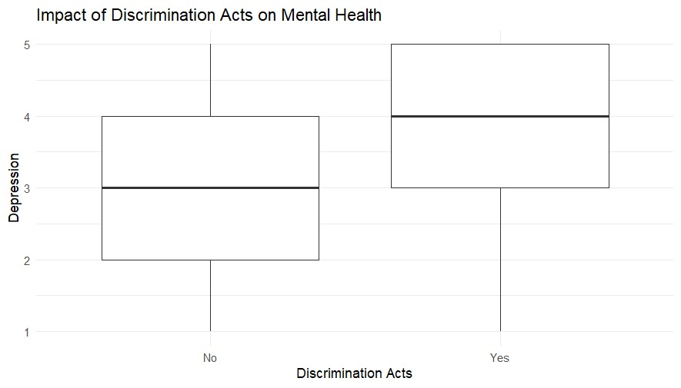
9. How do the discrimination acts affect mental health outcomes?
Students who had Discrimination acts show greater stress levels.

Slide 20
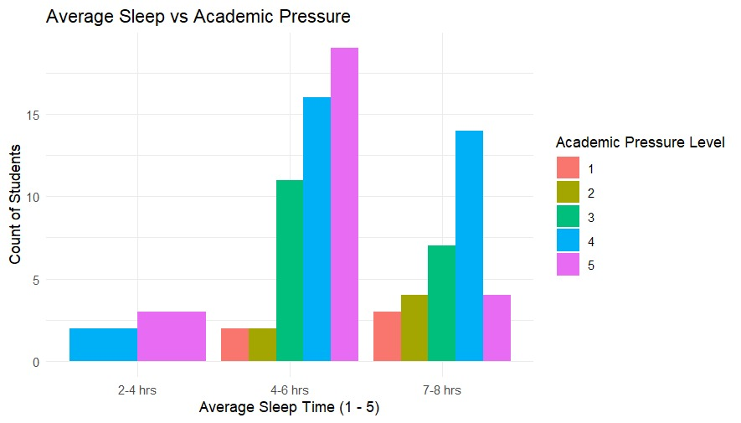
10. Is there a significant relationship between sleep time and academic pressure?
There is significant relationship between sleep duration and academic pressure.

Slide 21
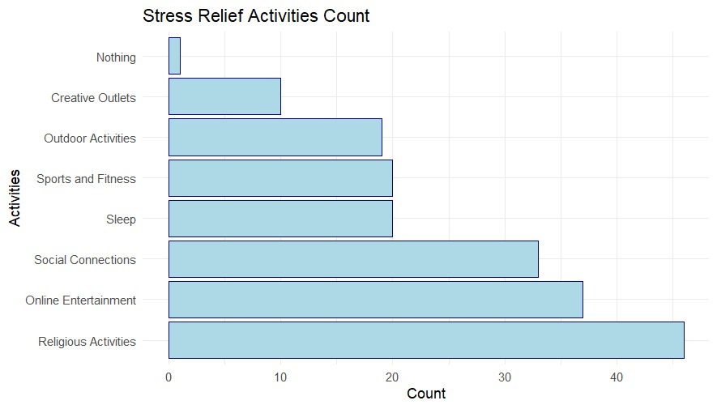
11. What is the most common stress relief activities and their effectiveness on reducing mental health issues?
Religious activities are the most common stress relief activities, and they are most effective methods.

